Slide 1
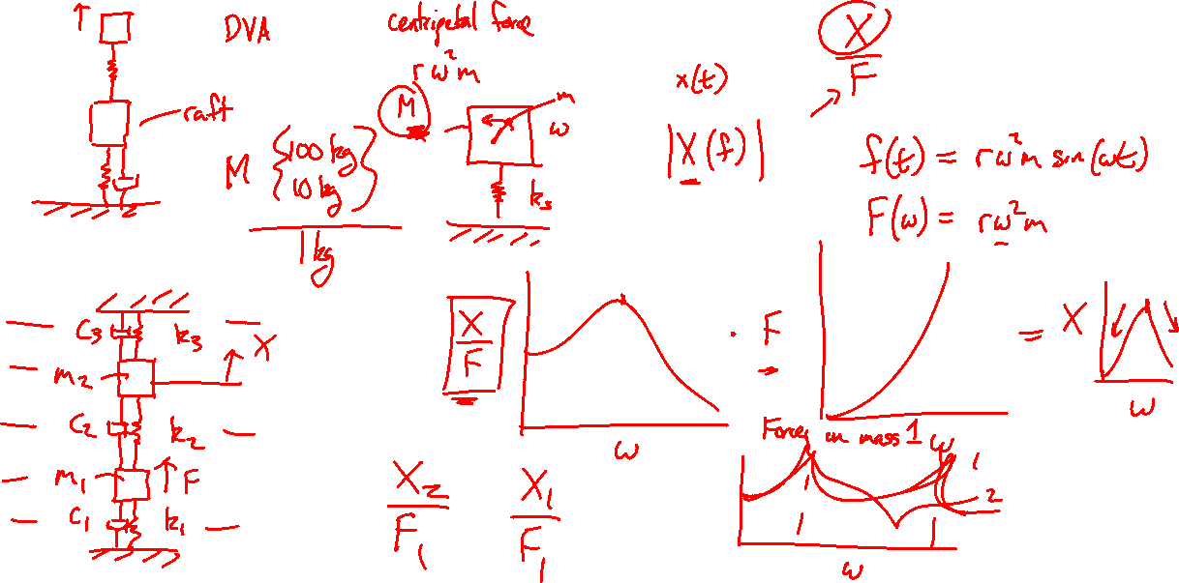

Slide 2

Vibration isolation
Transient response
Tyler Dare

Slide 3
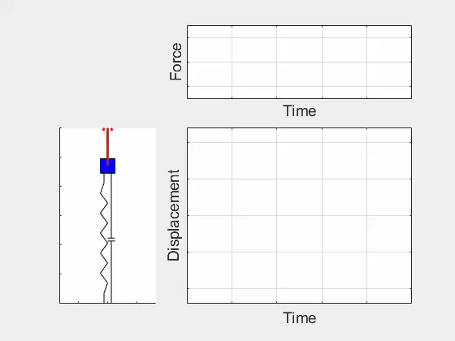

Transient response

Slide 4
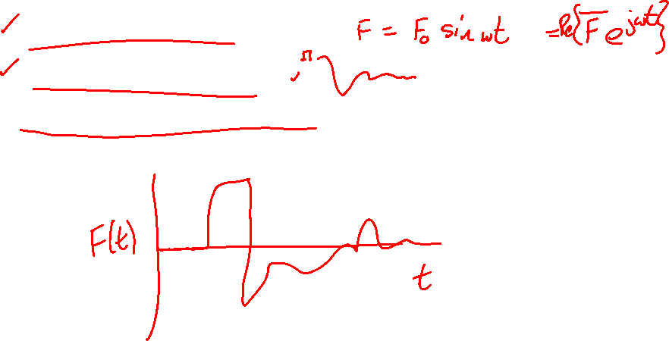
Transient response
Sinusoidal forcing (done)
Free response (done)
Arbitrary forced response

Slide 5
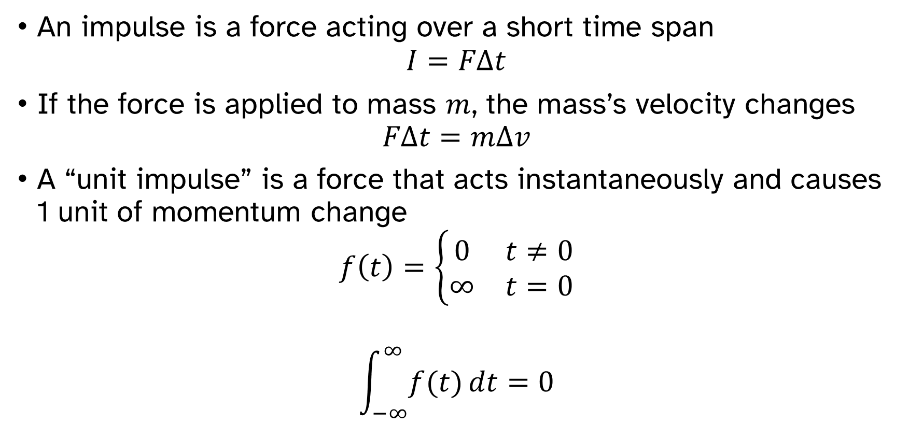
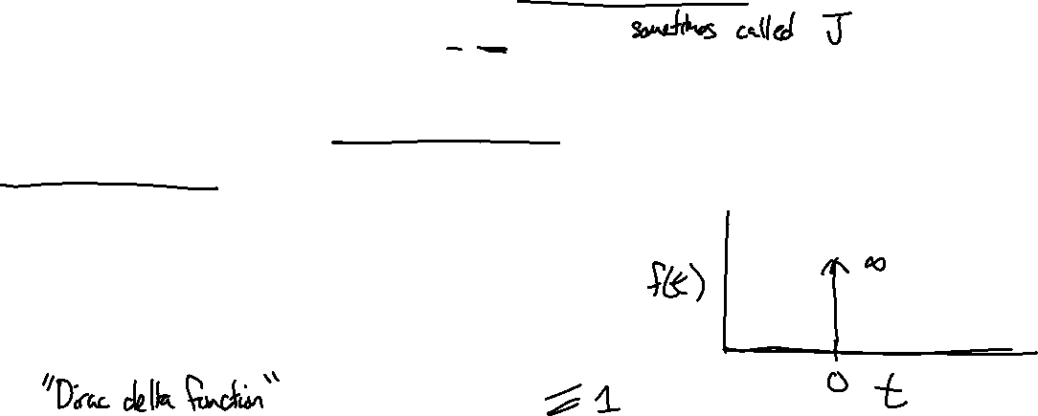
Impulse
An impulse is a force acting over a short time span
$$I=FΔt$$
If the force is applied to mass $m$, the mass’s velocity changes
$$FΔt=mΔv$$
A “unit impulse” is a force that acts instantaneously and causes 1 unit of momentum change
$$f\left(t\right)=\left\{\begin{matrix}0 & t≠0 \\ ∞ & t=0\end{matrix}\right.$$
$$\int_{−∞}^{∞}{f(t)}dt=0$$

Slide 6

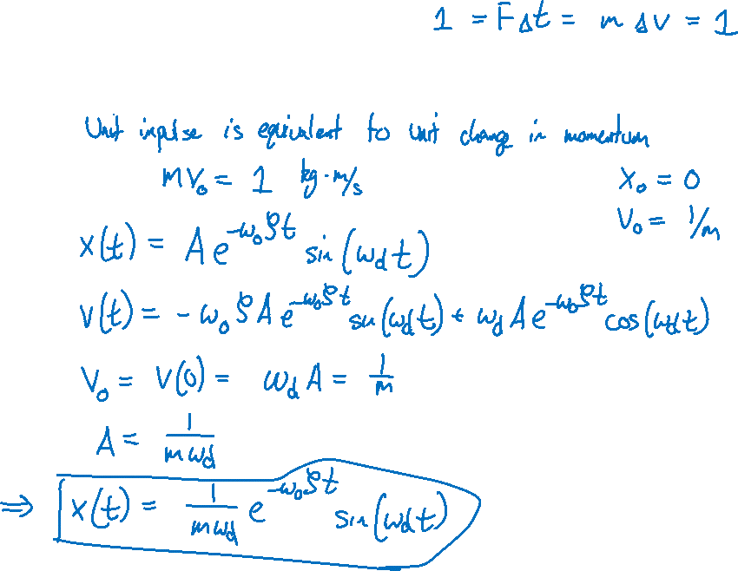
Impulse
How does a SDOF system respond to a unit impulse?
$m\ddot{x}+C\dot{x}+k_{s}x=F(t)$
$f\left(t\right)=\left\{\begin{matrix}0 & t≠0 \\ ∞ & t=0\end{matrix}\right.$
$\int_{−∞}^{∞}{f(t)}dt=0$

Slide 7
Impulse
How does a SDOF system respond to a unit impulse?

Slide 8

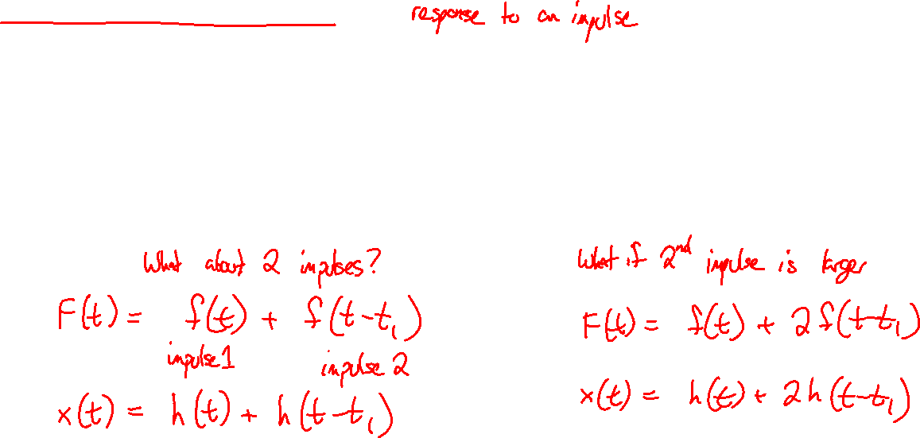
Impulse response function
$$h(t)=\frac{1}{mω_{d}}e^{−ω_{0}ζt}\sin\left(ω_{d}t\right)$$
How can the impulse response give the solution for arbitrary forces?

Slide 9

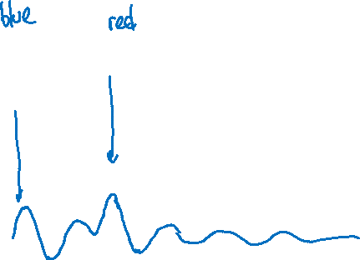
Impulse response function
$$h(t)=\frac{1}{mω_{d}}e^{−ω_{0}ζt}\sin\left(ω_{d}t\right)$$

Slide 10
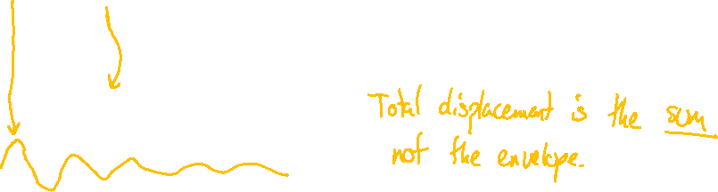
Impulse response function
$$h(t)=\frac{1}{mω_{d}}e^{−ω_{0}ζt}\sin\left(ω_{d}t\right)$$

Slide 11
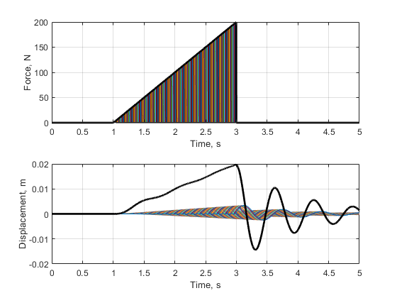

Impulse response function
$$h(t)=\frac{1}{mω_{d}}e^{−ω_{0}ζt}\sin\left(ω_{d}t\right)$$

Slide 12
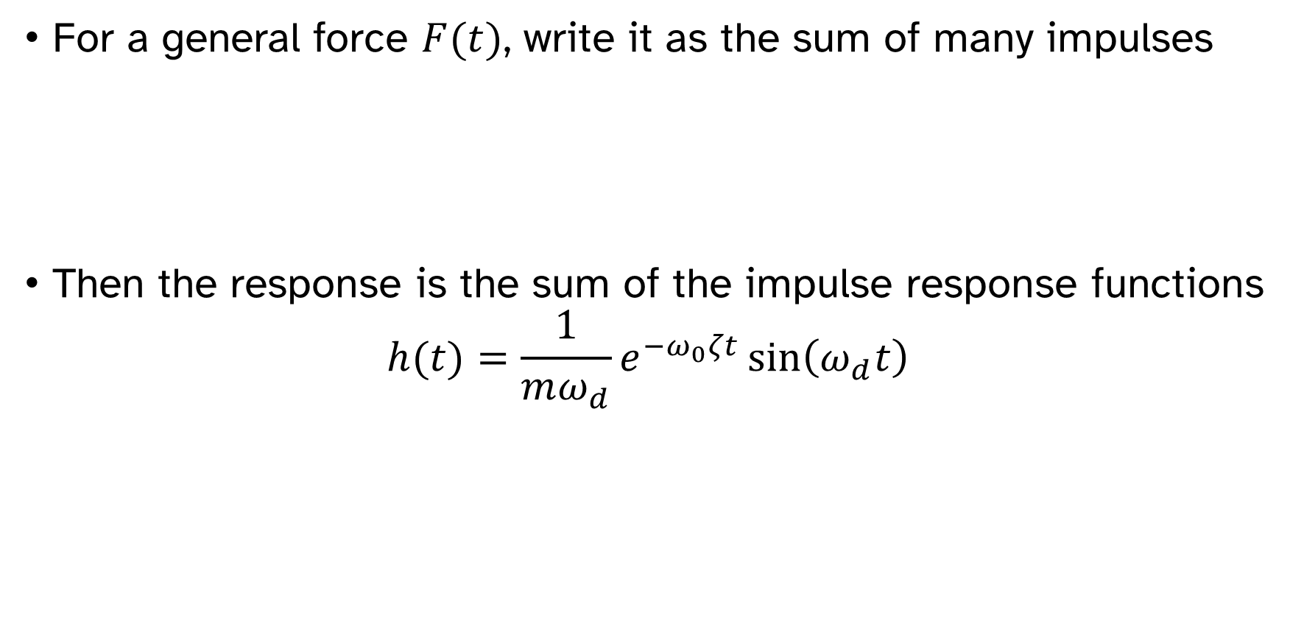
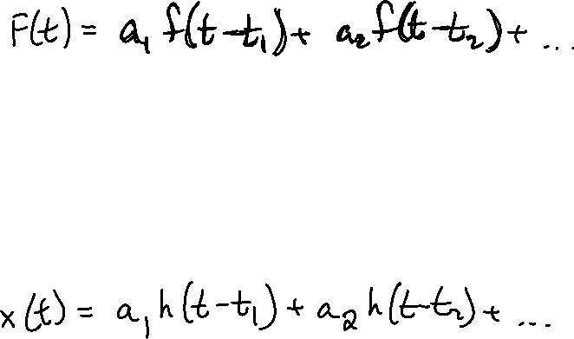
Impulse response function
For a general force $F(t)$, write it as the sum of many impulses
Then the response is the sum of the impulse response functions
$$h(t)=\frac{1}{mω_{d}}e^{−ω_{0}ζt}\sin\left(ω_{d}t\right)$$

Slide 13

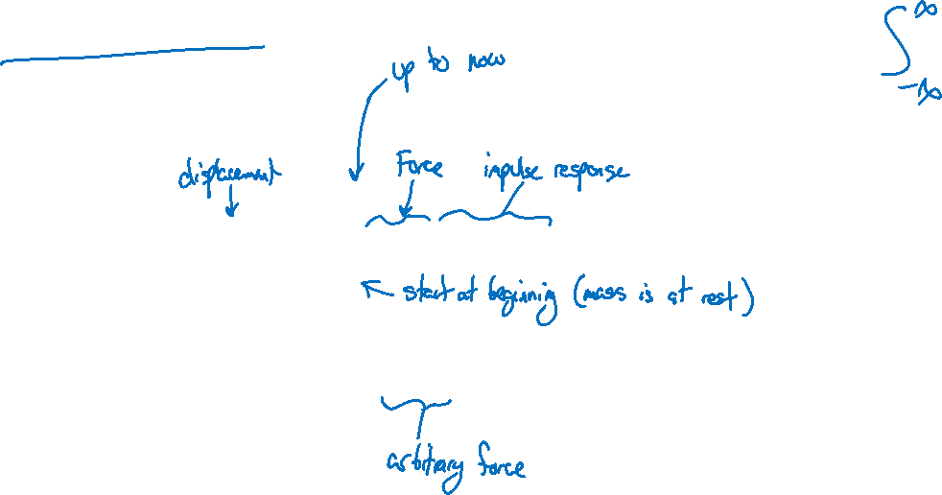
Duhamel’s integral
For arbitrary force $F\left(t\right)$, the response $x(t)$ is
$$x\left(t\right)=\int_{0}^{t}{F\left(τ\right)h\left(t−τ\right)dτ}=F(t)∗h(t)$$
$$x\left(t\right)=\frac{1}{mω_{d}}\int_{0}^{t}{F\left(τ\right)e^{−ω_{0}ζ\left(t−τ\right)}\sin\left[ω_{d}\left(t−τ\right)\right]dτ}$$

Slide 14
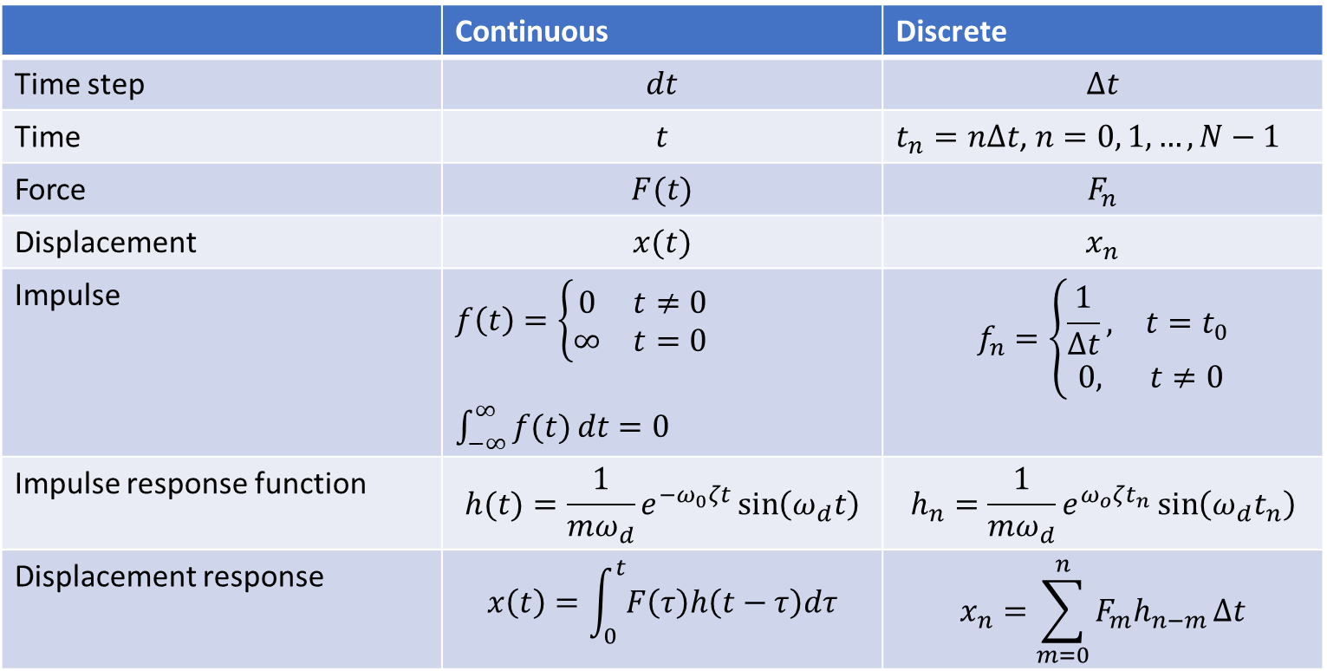
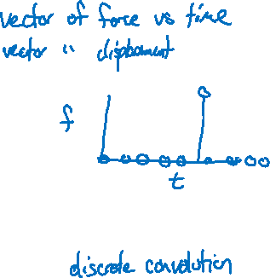
Duhamel’s integral
 | Continuous | Discrete
Time step | $$dt$$ | $$Δt$$
Time | $$t$$ | $t_{n}=nΔt$, $n=0, 1, …,N−1$
Force | $$F(t)$$ | $$F_{n}$$
Displacement | $$x(t)$$ | $$x_{n}$$
Impulse | $f\left(t\right)=\left\{\begin{matrix}0 & t≠0 \\ ∞ & t=0\end{matrix}\right.$ $\int_{−∞}^{∞}{f(t)}dt=0$ | $$f_{n}=\left\{\begin{matrix}\frac{1}{Δt}, & t=t_{0} \\ 0, & t≠0\end{matrix}\right.$$
Impulse response function | $$h(t)=\frac{1}{mω_{d}}e^{−ω_{0}ζt}\sin\left(ω_{d}t\right)$$ | $$h_{n}=\frac{1}{mω_{d}}e^{ω_{o}ζt_{n}}\sin\left(ω_{d}t_{n}\right)$$
Displacement response | $$x\left(t\right)=\int_{0}^{t}{F\left(τ\right)h\left(t−τ\right)dτ}$$ | $$x_{n}=\sum_{m=0}^{n}{F_{m}h_{n−m}}Δt$$

Slide 15
Impulse response function
$$h(t)=\frac{1}{mω_{d}}e^{−ω_{0}ζt}\sin\left(ω_{d}t\right)$$

Slide 16
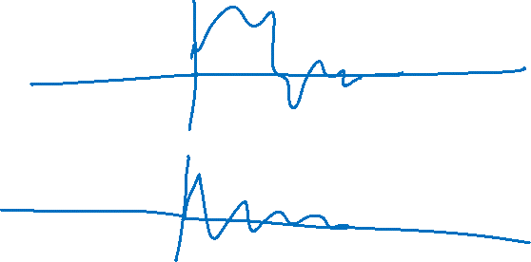
Duhamel’s integral in MATLAB
MATLAB’s conv function is very useful, but must be used correctly.
x will not be the same length as F. You will need to generate a new time vector.
F is assumed to be zero where it is not defined.
x = conv(F,h)*dt;
t_conv = (0:2*N-2)*dt;

Slide 17
Duhamel’s integral

Slide 18

Duhamel’s integral

Slide 19
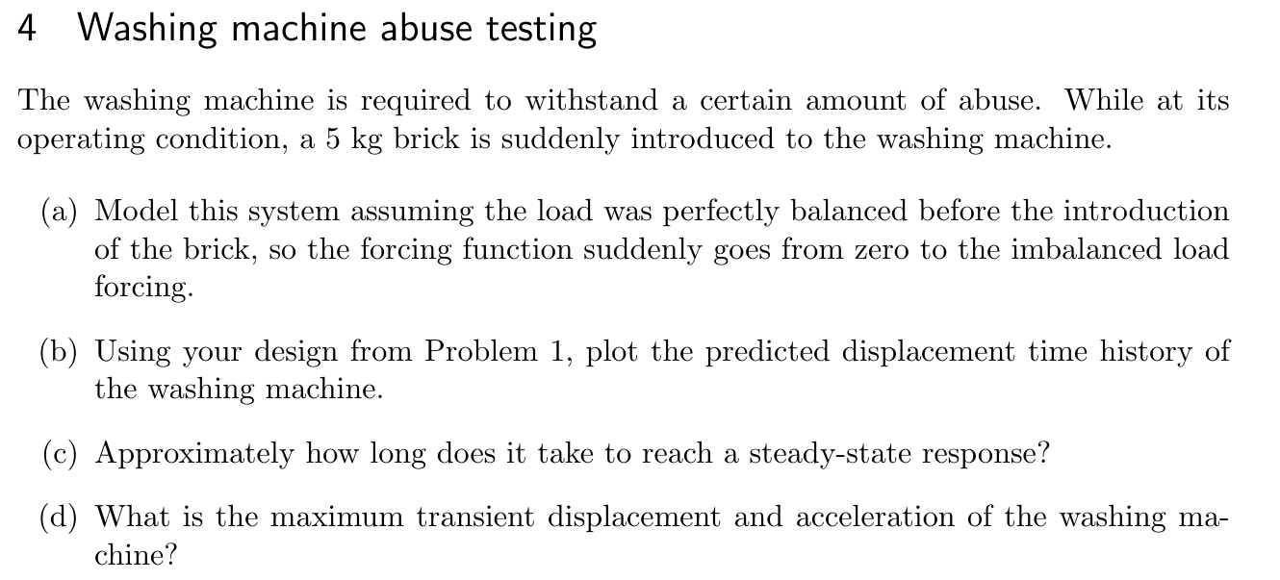
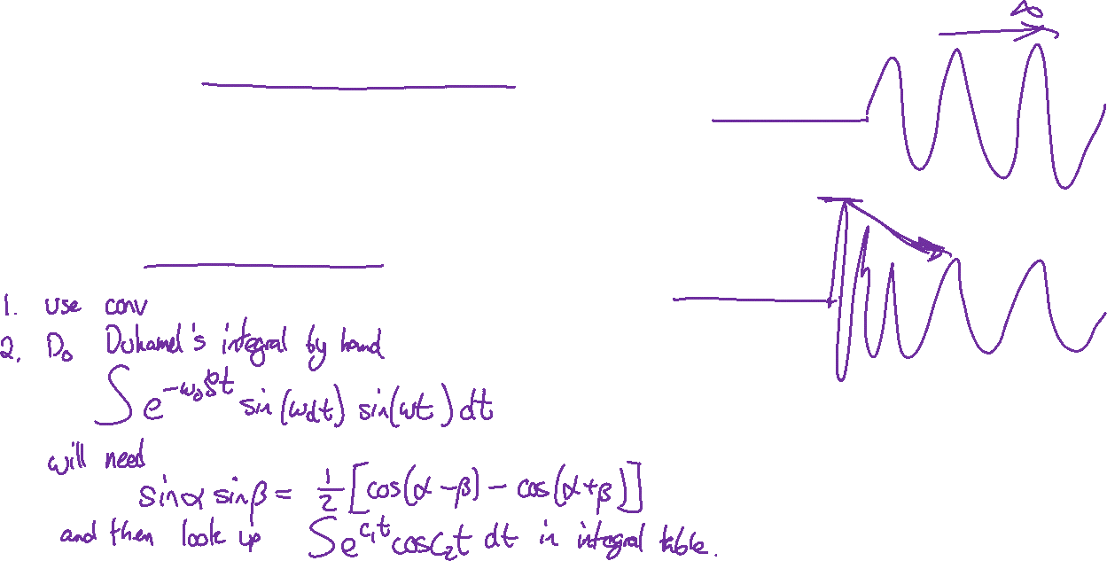

Slide 20
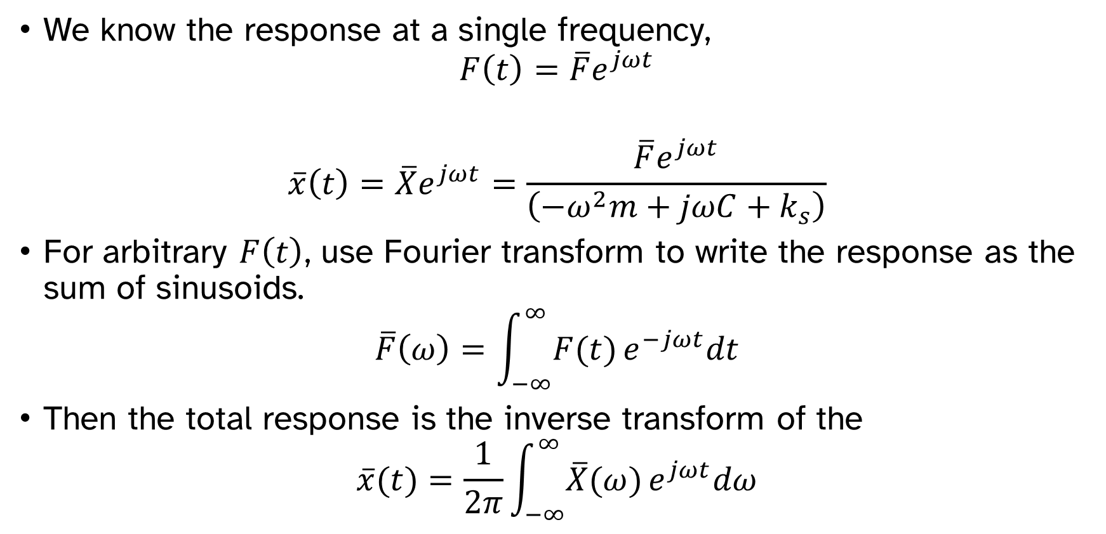

Arbitrary forced response via Fourier transforms
We know the response at a single frequency,
$$F\left(t\right)=\overline{F}e^{jωt}$$
$$\overline{x}\left(t\right)=\overline{X}e^{jωt}=\frac{\overline{F}e^{jωt}}{\left(−ω^{2}m+jωC+k_{s}\right)}$$
For arbitrary $F\left(t\right)$, use Fourier transform to write the response as the sum of sinusoids.
$$\overline{F}\left(ω\right)=\int_{−∞}^{∞}{F(t)}e^{−jωt}dt$$
Then the total response is the inverse transform of the
$$\overline{x}(t)=\frac{1}{2π}\int_{−∞}^{∞}{\overline{X}(ω)}e^{jωt}dω$$

Slide 21


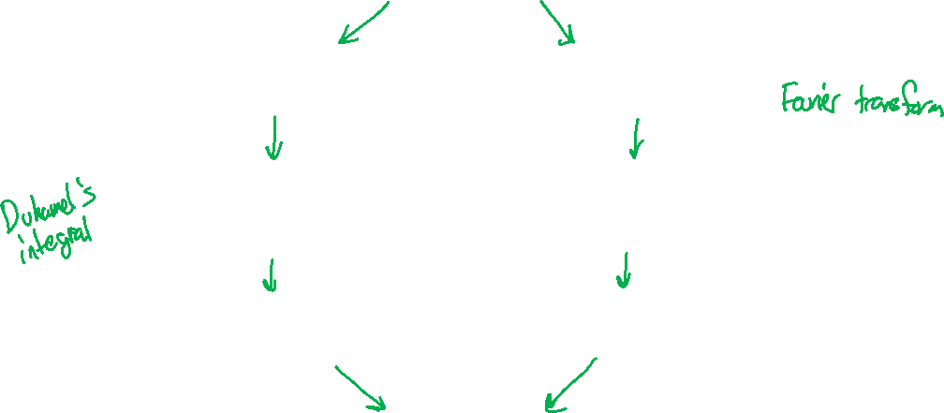
Arbitrary forced response
$$F(t)$$
Write as sum of impulses
Write as sum of sinusoids
Compute response to each impulse
Compute response to each sinusoid
Add responses together
Add responses together
$$x(t)$$

